Slide 1



Title –
Design of IOT Architecture for
Battery Charging Management Technology
Major project 2nd Review Presentation
Presented by
Jagadeesh_(AP2312210002)
under the Esteemed guidance of
Dr. Sujith Kalluri Ph.D
Associate Professor
School of Engineering and Sciences (SEAS)
Department of Electronics and Communication Engineering
SRM University, Andhra Pradesh (SRM AP)

Slide 2








About Me
Profile
Name – Jagadeeswara Chandra bose. K
I am M. Tech student in Embedded Systems and IoT with 2 years of industry experience and a passion for developing affordable utility products to help underprivileged communities.
objective
My career objective is to continuously develop and redefine my skills and expertise in edge technologies.
Internships & Experience
I am passionate about to creating a platform that transforms an ecosystem to support my friends and society, particularly those who are financially underprivileged.
Contact info
Jatayujagadeesh@gmail.com
+91 – 9705233003
Guntur district, Andhra Pradesh
Education
M. Tech in Embedded Systems and IoT - CGPA: 8.50
B. Tech in Electrical and Electronics Engineering - CGPA: 71.10
Diploma in Electrical and Electronics Engineering - 71.20%
SSC - 82%

Slide 3

Outline
Problem statement & Research gap
Designed Architecture for Charging Management
Proposed System & Methodology
MATLAB Simulation
Numerical Estimation Energy and cost Saving
Solar, ESS, Grid – Integration
PCC – Point of Common Coupling – Automation
ESS – Energy Storage system
30 – Battery Swapping System
4 – Fast Charging System
Data Acquisition

Slide 4

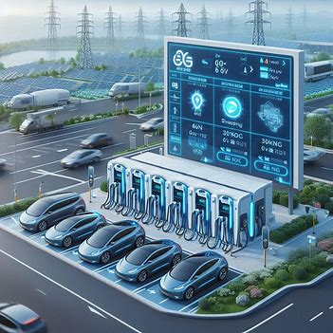
Problem Statement and Research Gap with IOT Tech
Lack of Pollution – need More Transportation – Need coal mines – More Generation cost
Why IOT needed
Real Time Data Monitoring
Pre estimation Power Demand
To Reuse Harmonic's Imbalance
Central Monitoring System
End User Integration
EV are Rapidly Increasing in the world Automotive Market
So, There is a Demand of Charging Infra

Slide 5
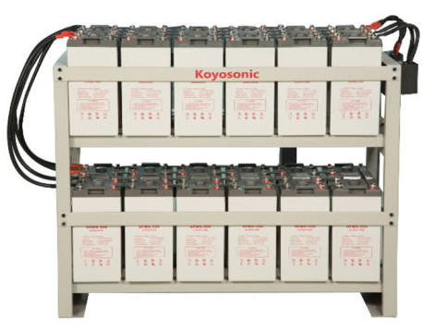
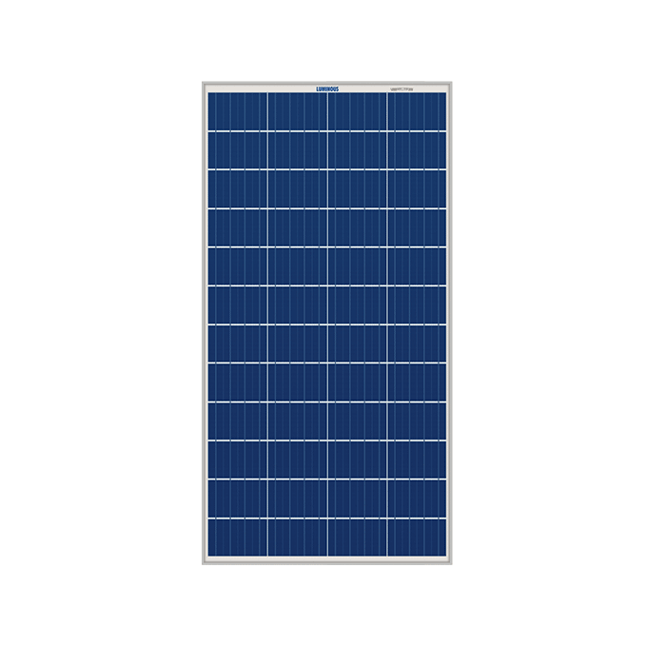
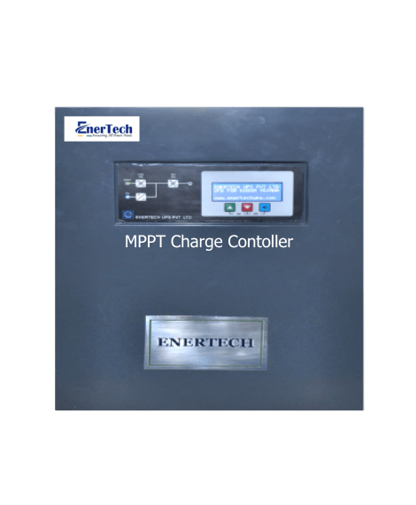





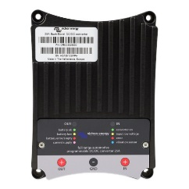

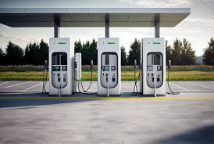


Proposed Methodology
Bi directional converter
Grid
MPPT
Central Control Monitoring
Solar
ESS
Buck – Boost converter
Cloud
Swapping
Fast Charging
User Interface

Slide 6

User Interface Application Layer
IOT Architecture for Battery charging management
Application Layer
Presentation Layer
Session Layer
Transport Layer
Network Layer
Data Link Layer
Physical Layer
Cloud Server Layer Data storage
Communication Layer IoT Gateway Layer Processing Layer
Microcontroller Layer BMS Layer Data Acquisition Layer Processing Unit Layer
Sensor Layer

Slide 7
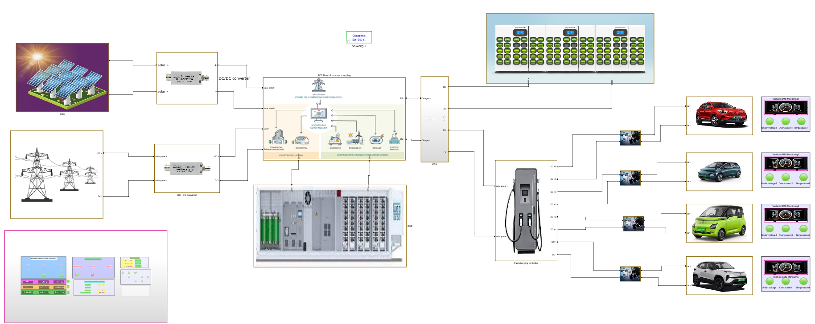
Designed Proposed Simulation Model in MATAB Simulation
Swapping Station
Solar
Converter
PCC
Divider
Charging
Monitoring
Vehicles
Converter
Grid
ESS
Fast Charging
Central Monitoring System

Slide 8



Integrated Power Sources – IOT Based Monitoring Parameters
Voltage Output: Measures the voltage generated.
Current Output: Monitors the current produced.
Power Generation: Calculates power output (P = V × I).
Temperature: Assesses panel temperature for efficiency.
Light Intensity: Measures sunlight exposure.
Fault Detection: Identifies malfunctions or short circuits.
Voltage 430V
Current 100A
Power KW/h 43KW
Power / Day 1032KW
Generation in day - 60%
State of Charge (SoC): Available battery capacity as a percentage.
Voltage: Voltage of individual cells or overall battery bank.
Current: Charging and discharging current measurements.
Temperature: Battery temperature for optimal performance.
Charge/Discharge Cycles: Tracking the number of cycles for lifespan prediction.
Fault Detection: Identifying issues like short circuits or imbalances.
Voltage 480 V
Current 50 A
Power KW/h 24 KW
Power / Day 576 KW
Generation in day - 30%
Voltage: Voltage of individual cells or overall battery bank.
Current: Charging and discharging current measurements.
Converter: AC – DC – DC – DC – DC – AC - Bidirectional converter
Fault Detection: Harmonics or any Faults.
Voltage 435 V
Current 20 A
Power KW/h 9KW
Power / Day 209 KW
Generation in day - 10%

Slide 9
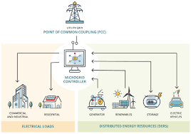
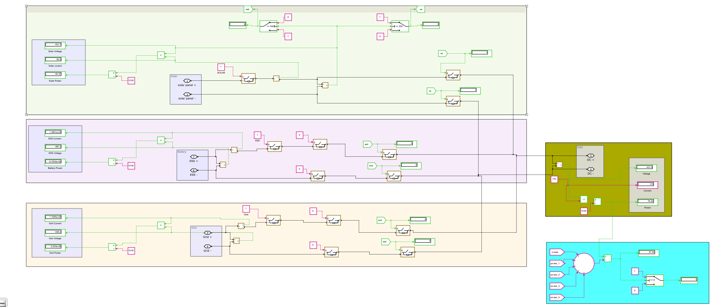
Integrated PCC – Point of common coupling – Fully Automated & Logically connected
Solar
ESS
PCC
Output
Grid
Power Management
Conditions
Solar – ON -- ESS charge Grid OFF -- ESS >80% ESS → Grid
Solar – OFF -- ESS ON Grid OFF
Solar – OFF -- ESS <20% Grid ON ESS charge
Output of PCC
Voltage 430 V
Current 80 A
Power KW/h 75 KW
Power / Day 1800 KW

Slide 10
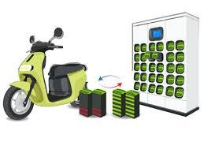
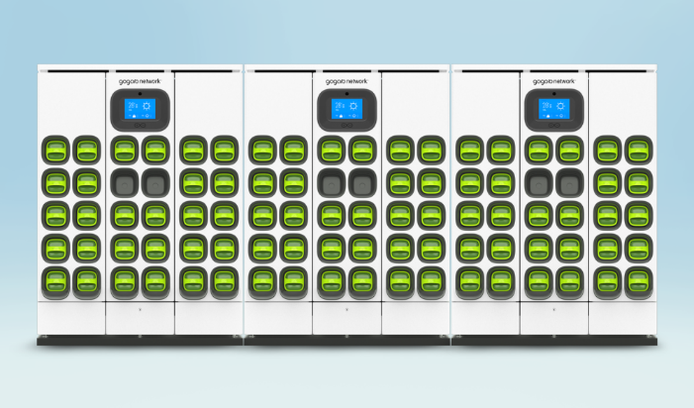
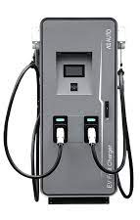
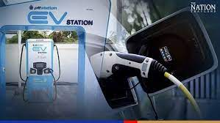

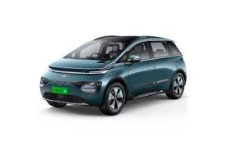


Swapping Station and DC Fast Charging
State of Charge (SoC): Available battery capacity as a percentage.
Battery Voltage: Voltage of individual battery packs.
Battery Current: Charging and discharging current measurements.
Battery Temperature: Monitors battery temperature for safety.
Swapping Time: Measures time taken for each battery swap.
Energy Usage: Measures of energy consumed during swaps.
Fault Detection: Identifies issues like short circuits.
Batteries – 30
Voltage - 12
Current - 10A
Power/ battery – 0.12kw
Cars | Voltage (V) | Power (kW) | Battery Capacity (kWh) | SOC Avaliable | Required Current | Charging Time in hr | Unit charge | Cost
1 - Tata Nexon - EV | 400 | 30.2 | 30.2 | 20 | 75.5 | 2.47 | 10 | 745.83
2- MG ZS EV | 400 | 50 | 44.5 | 30 | 125 | 1.49 | 10 | 743.75
3-Tata Trigo EV | 400 | 16.8 | 26 | 50 | 42 | 4.40 | 10 | 739.58
4- Mahindra eVerito | 400 | 70 | 60 | 10 | 175 | 1.07 | 10 | 747.92
Total Power |  | 167 |  |  | Total Time | 9 | Total Revenue | 2977

Slide 11
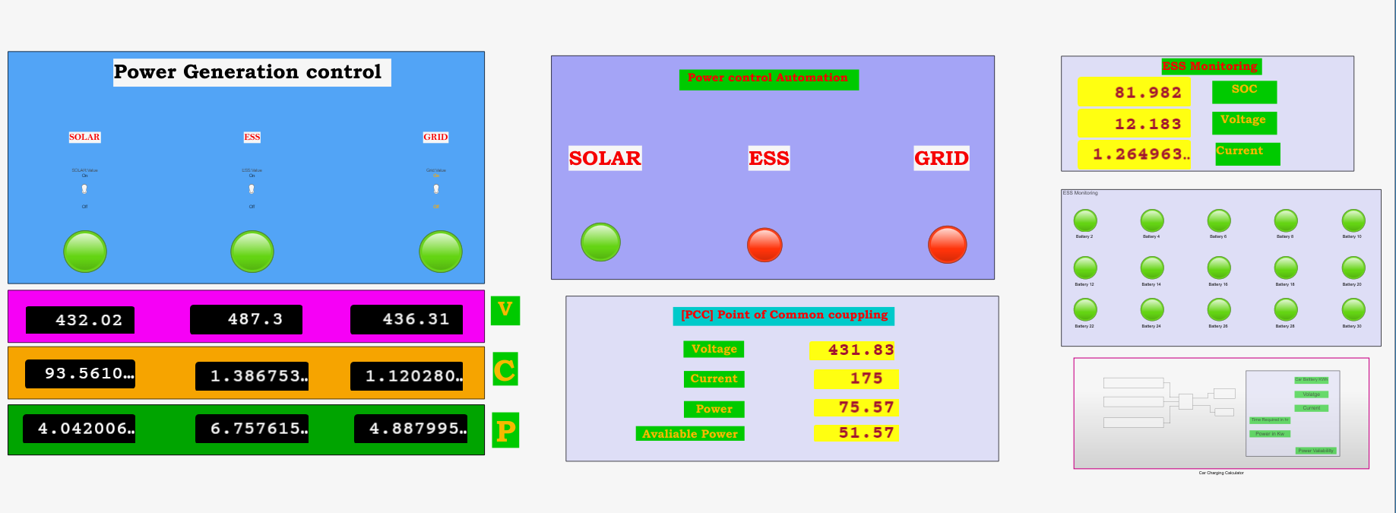
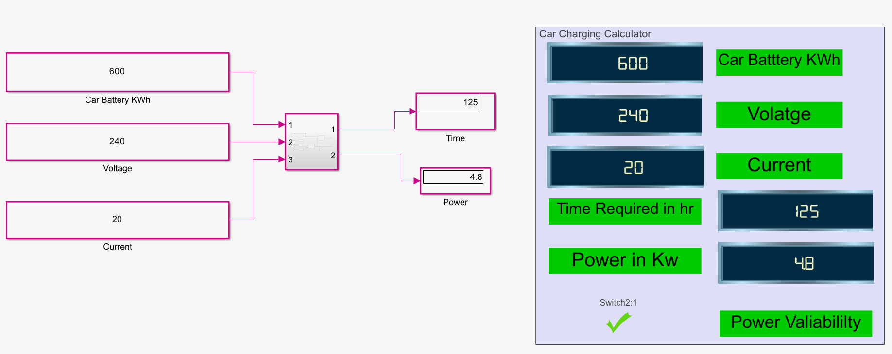
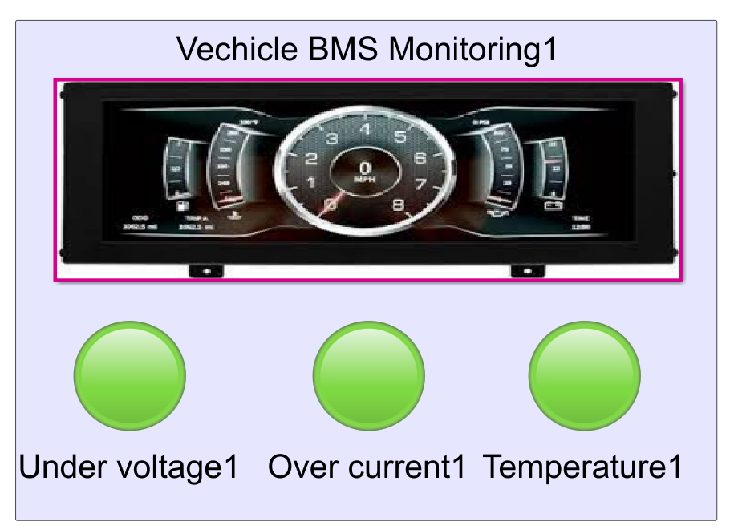
Central Monitoring Station
EV Parameters calculation
EV Battery charging Parameters

Slide 12
Power Generation |  |  |  |  |  |  | PCC - Point of common coupling |  |  |  |  | ESS - Charging
Power Source | Voltage [V] | Current [I] | % of Generation/day | Power [P]- KWh | Power/day |  | PCC will Logically be controlled on avalibility of source |  |  |  |  | No.of batteries | 40
Solar | 430 | 100 | 60 | 43 | 1032 |  | Voltage - [V] | 430 | Output Power/day in KW |  |  | Voltage | 12
ESS | 480 | 50 | 30 | 24 | 576 |  | Current - [I] | 80 |  |  |  | Amper hour - capacity | 100
Grid | 435 | 20 | 10 | 9 | 209 |  | Power - [W] - KW/h | 75 | 1800 | Gen /day |  | Power / charge - Watt / hr | 48000
Total Power Generation per day in KW/24 hr |  |  |  |  | 1817 |  | Power Avaliability | 1.17 | 1772 | use / day |  | Power / one cycle charge - KW | 48
Fast Charging Station Load
Cars | Voltage (V) | Power (kW) | Battery Capacity (kWh) | SOC Avaliable | Required Current |  | Charging Time in hr |  | Unit charge | Cost
1 - Tata Nexon - EV | 400 | 30.2 | 30.2 | 20 | 75.5 |  | 2.47 |  | 10 | 745.83
2- MG ZS EV | 400 | 50 | 44.5 | 30 | 125 |  | 1.49 |  | 10 | 743.75
3-Tata Trigo EV | 400 | 16.8 | 26 | 50 | 42 |  | 4.40 |  | 10 | 739.58
4- Mahindra eVerito | 400 | 70 | 60 | 10 | 175 |  | 1.07 |  | 10 | 747.92
Total Power |  | 167 |  |  | Total Time |  | 9 |  | Total Revenue | 2977
Total Power |  | 1670 | KW power can charge / day |  | Total Time |  | 94 | / 96 hr | Total Revenue | 26794
Battery Swapping Station
Total Batteries | 30
Under maintance | 0
Avaliable batteries | 30
Voltage | 12 |  | Total Batteries charging / day |  |  | 90
Current | 10 |  | Cost of charge per battery |  |  | 30
Time / Battery in hr | 5 |  | Total Amout Per day |  |  | 2700
No of Cycle per day | 3
Power/Battery - KW | 0.12
Total Station KW | 18
Total Energy Required for Full Swapping Station per Day - KW | 54

Slide 13
Total Energy calculation
Power sources | KW / day | KW / Month | KW / year | KW / 5 years
Required full Power From Grid | 1,817 | 54,504 | 663,132 | 3,315,660
Solar | 1,032 | 30,960 | 376,680 | 1,883,400
ESS | 576 | 17,280 | 210,240 | 1,051,200
Grid | 209 | 6,264 | 76,212 | 381,060
Total Power saving / Day | 1,608 | 48,240 | 586,920 | 2,934,600
Total Cost / Day 12rs / unit | 21,802 | 654,048 | 7,957,584 | 39,787,920
Total Cost Saving / Day 12rs / unit | 19,296 | 578,880 | 7,043,040 | 35,215,200
Spending Amount | 2,506 | 75,168 | 914,544 | 4,572,720
Revenue
Source | Per day | Per Month | Per Year | Per 5 Years
Fast charging | 26,794 | 803,813 | 9,779,719 | 48,898,594
Battery Swapping | 2,700 | 81,000 | 985,500 | 4,927,500
Total Revenue | 29,494 | 884,813 | 10,765,219 | 53,826,094
Spending Amount | 2,506 | 75,168 | 914,544 | 4,572,720
Total Profit | 26,988 | 809,645 | 9,850,675 | 49,253,374

Slide 14
Tools Used
MATLAB Simulation
Spreadsheet
Conclusion
Energy Source Integration
Optimized Charging Solutions
Energy Cost Saving
Future Stability
Pending
AWS Cloud Integrations
User Interface
Future Works
1. Hardware setup

Slide 15

Thankyou
Talk to yourself once in a day,
otherwise, you may miss meeting an intelligent person in this world. Swami Vivekananda
Harnessing renewable energy through innovative battery charging solutions not only reduces operational costs but,
IOT Integration is the way for a sustainable future, enabling us to power our vehicles while preserving our planet.

Slide 16


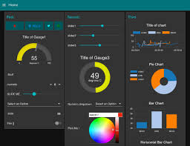
Collected Data
Storage
Central control Pannel
User Interface

